Slide 1

Monitoring Microservices
AKHIL MURALI AMITHA MARY BENNY DEVIKA BIJO MEENAKSHI SAJEEVAN
GOLDEN EAGLES

Slide 2

TOPICS COVERED
Prometheus
Grafana
ELK
Splunk
Trampoline
Jaeger

Slide 3



Prometheus
Monitoring Tool
Highly dynamic container environment
Non container infrastructure

Slide 4
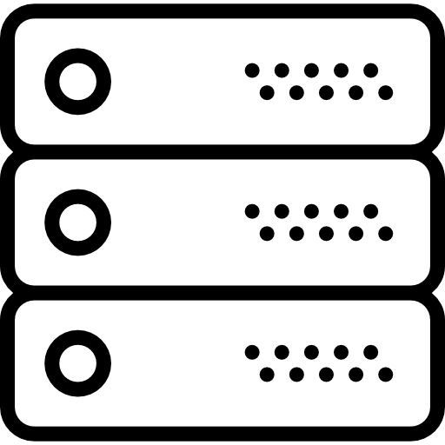

Prometheus (Why and Where)
Response Latency
Overloading
Errors (exceptions)
Enough Resources
Downtime

Slide 5


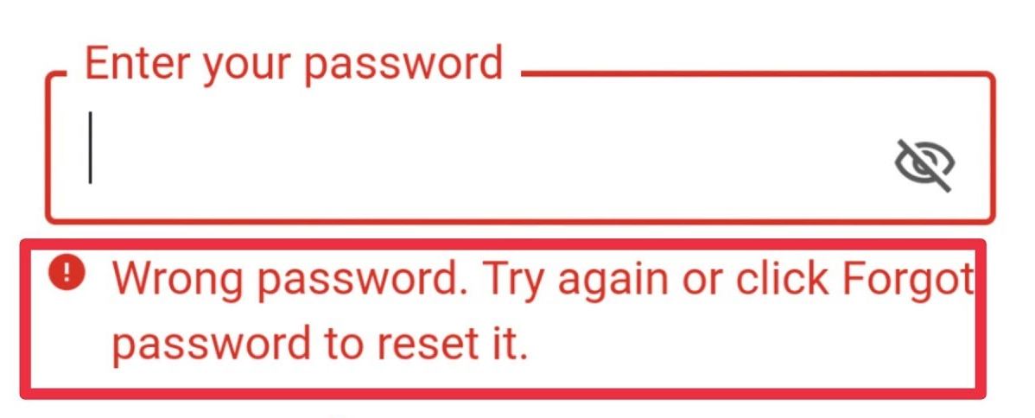
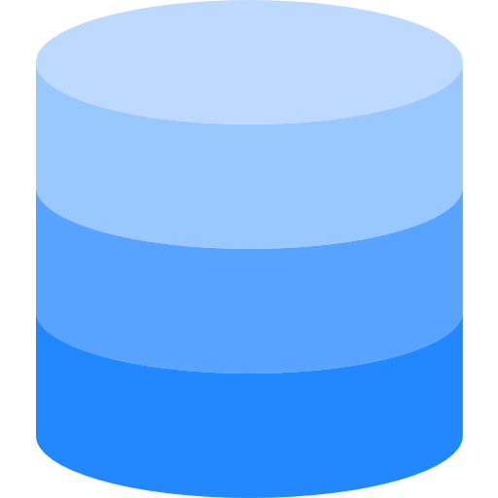

Prometheus (Why and Where)
Error:
"Authentication Failed"

Slide 6
Prometheus (Why and Where)
Alerts when crashes
Constantly monitor
Identify problems before
Checks memory usage
Notify Admin

Slide 7
Prometheus (Main Components)
Prometheus Server
Retrieval
Storage
HTTP Server
Pulls metrics data
Stores metrics data
Accepts queries
Data Retrieval Worker
Time Series Database
Accepts PromQL Queries
Notes:
Current CPU Usage, No of Exception
From Applications, Services, Servers and stores them in DB
Display data using Prometheus Web UI or Grafana

Slide 8
Target and Metrics
Linux/Windows Server
Single Application
Apache Server
Service like Database
CPU Status
Disk Space Usage
Exception Count
Request Count
Request Duration
Targets
Metrics
Unit

Slide 9
Metrics
Attributes
HELP: Description of metrics
TYPE:
Counter: How many times x happened
Gauge: What is the current value of x now
Histogram: How long
Notes:
How many request are made? How many exceptions are occurred
What is the current CPU Usage? What is the current disk space?
How long was some request

Slide 10

Grafana
Open Source
Data Visualization
Charts, Graphs, Dashboards
Various monitoring tools like Prometheus, InfluxDB
Notes:
Grafana is an open-source data visualization and monitoring tool used to create real-time dashboards for analyzing and displaying metrics from various data sources.

Slide 11
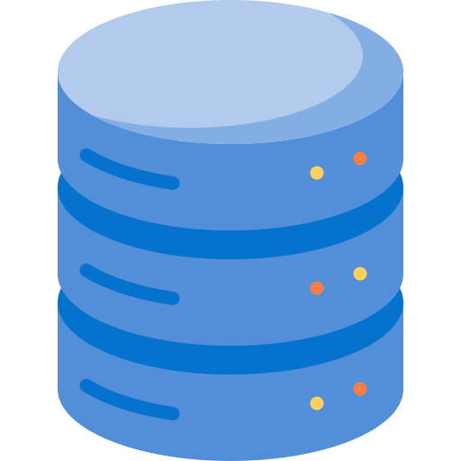


Grafana
Dashboard
Data Source
(Prometheus, InfluxDB)
Data Producer (Kubernetes Pods, IoT Devices, VMs, etc.)

Slide 12
Grafana
Metrics: CPU Load, Current Memory Usage, Temperature
Log: Timestamp, Logging level, Description

Slide 13
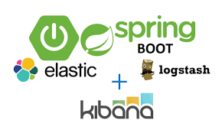
ELK(Elasticsearch, Logstash, and Kibana)

Slide 14
What is ELK?
The ELK Stack consists of three open-source products - Elasticsearch, Logstash, and Kibana from Elastic.
Elasticsearch is a NoSQL database that is based on the Lucene search engine.
Logstash is a log pipeline tool that accepts inputs from various sources, executes different transformations, and exports the data to various targets.
Kibana is a visualization UI layer that works on top of Elasticsearch.

Slide 15
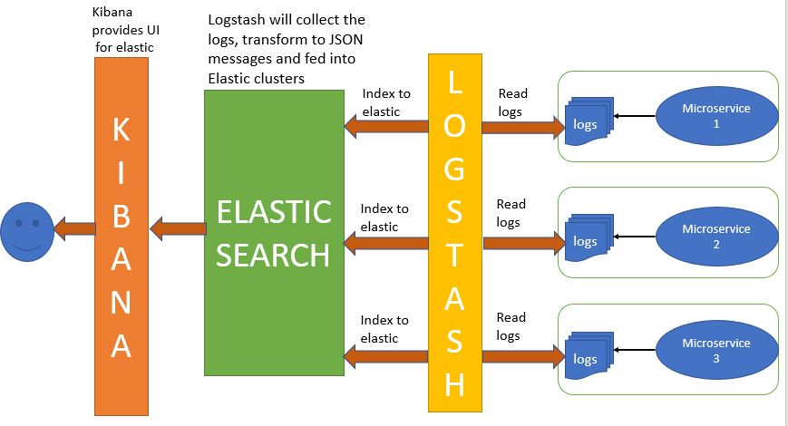
Architecture

Slide 16
Need for it?
These are used together for log analysis in various environments.
Logstash collects and parses logs, Elastic search indexes and store this information.
Kibana provides a UI layer that provide actionable insights.

Slide 17
Use Cases
Consider you have a single application running and it produces logs. Now suppose you want analyze the logs generated. One option is to manually analyze them. But suppose these logs are large, then manually analyzing them is not feasible.
Suppose we have multiple Application running and all these applications produce logs. If we have to analyze the logs manually we will need to go through all the log files. These may run into hundreds.
We can use ELK here to analyze the logs more efficiently and also using more complex search criterias. It provides log aggregation and efficient searching.

Slide 18
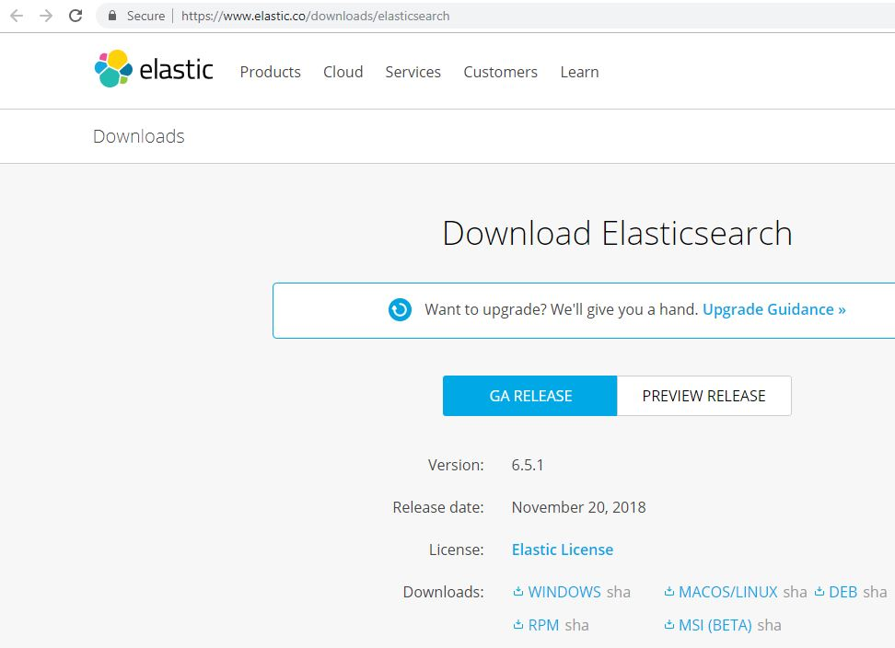
Elasticsearch

Slide 19
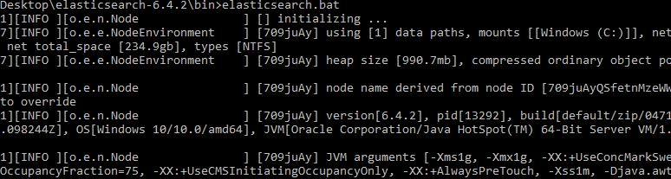
Elasticsearch
Run the elasticsearch.bat using the command prompt.
Elasticsearch can then be accessed at localhost:9200

Slide 20
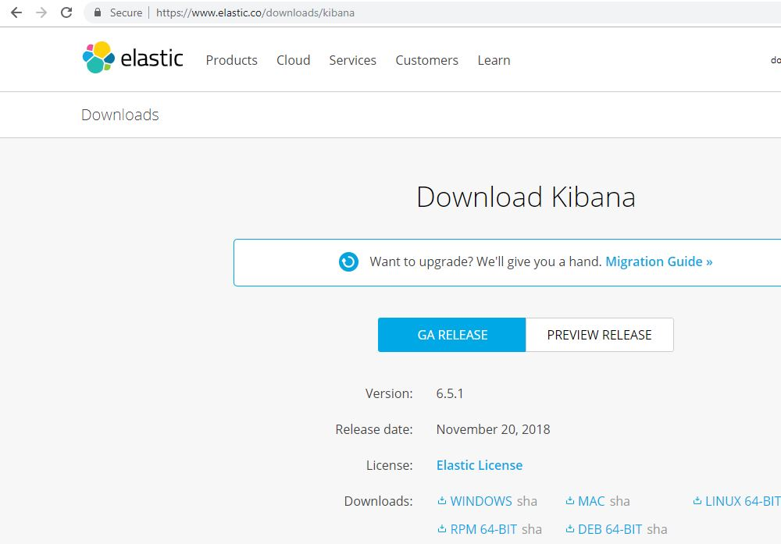
Kibana

Slide 21
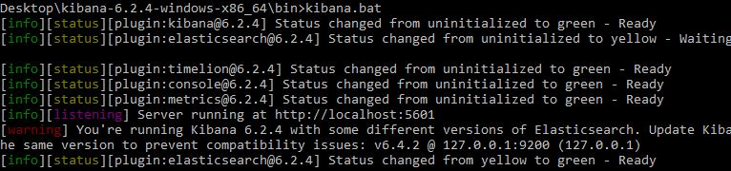
Kibana
Modify the kibana.yml to point to the elasticsearch instance.
Run the kibana.bat using the command prompt. kibana UI can then be accessed at localhost:5601

Slide 22
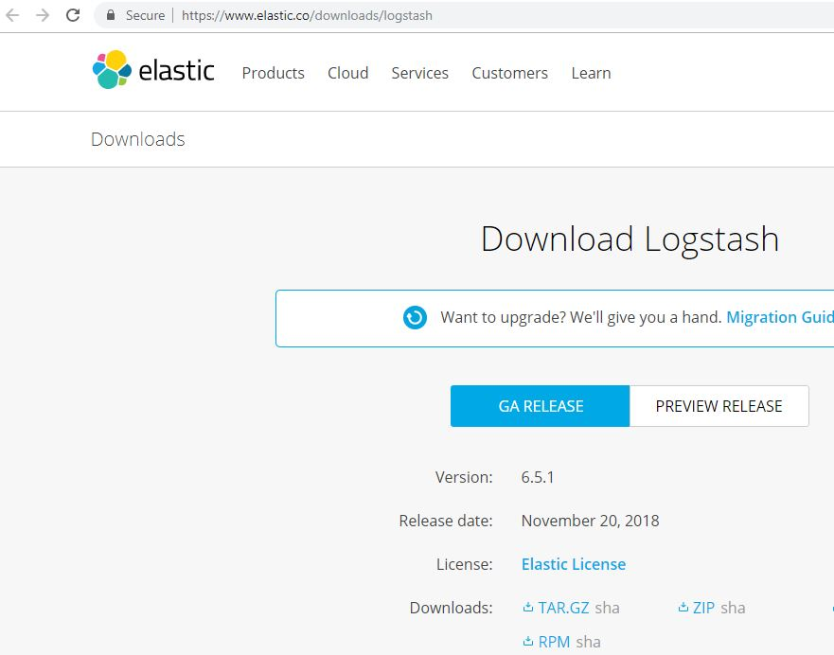
Logstash

Slide 23
Logstash
When using the ELK stack we are ingesting the data to elasticsearch, the data is initially unstructured. We first need to break the data into structured format and then ingest it to elasticsearch. Such data can then be later used for analysis.
This data manipulation of unstructured data to structured is done by Logstash.
Logstash itself makes use of grok filter to achieve this.

Slide 24
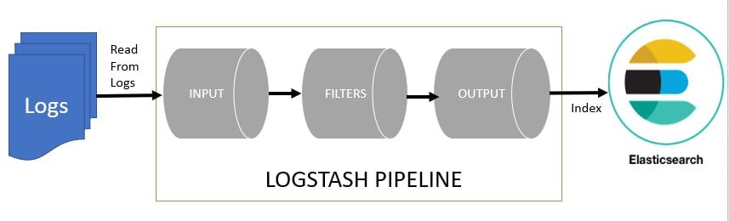
Logstash
You can make use of the Online Grok Pattern Generator Tool for creating, testing and debugging grok patterns required for logstash.

Slide 25
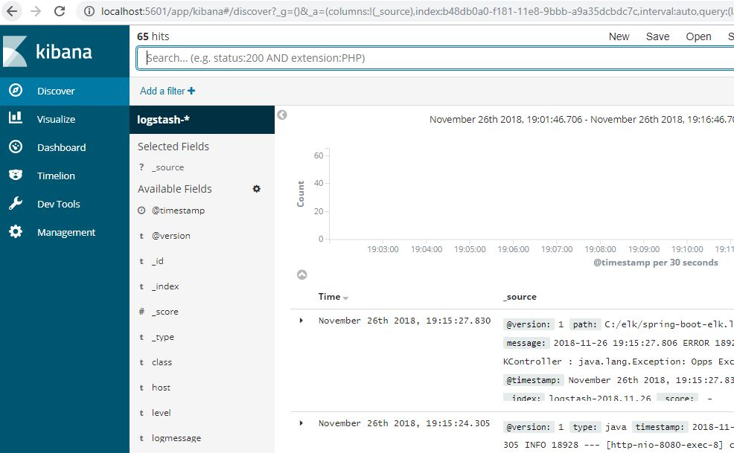
Kibana UI console

Slide 26


Slide 27
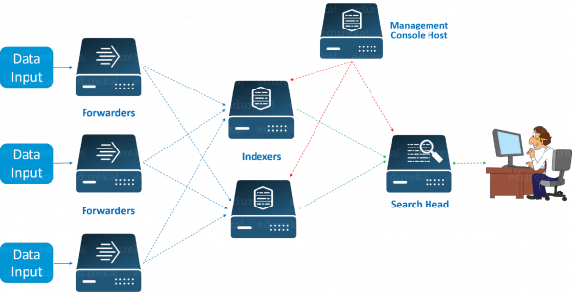
Splunk
Splunk is a software platform widely used for monitoring, searching, analyzing and visualizing the machine-generated data in real time.
It performs capturing, indexing, and correlating the real time data in a searchable container and produces graphs, alerts, dashboards and visualizations.

Slide 28

HOW IT’S WORKS?
Forwarder: It gather the records from far off machines then forwards records to the Index in real-time.
Indexer: Indexer procedure the incoming records in real-time. It additionally stores & Indexes the records on disk.
Search Head: End customers have interactions with Splunk via Search Head. It lets in customers to do search, analysis & Visualization.

Slide 29
NEEDS OF SPLUNK
It is a form of Google for log report browsing.
Searches the usage of easy phrases with seek processing language (SPL).
Splunk device has direct garage facility, this means that there’s no backend garage required.
You can enter statistics in any layout i.e. json, .csv, or some other layout.
You can assign Alerts/Events in Splunk.
You could make a specific estimation of the sources you want to scale up the infrastructure.

Slide 30
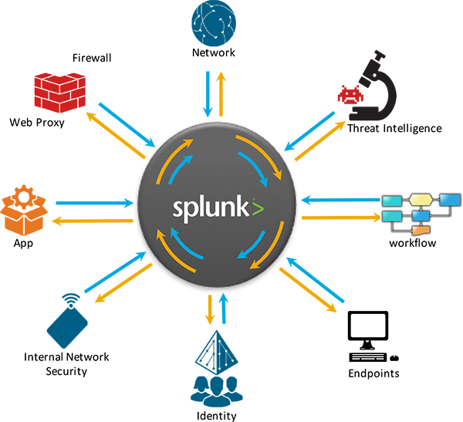
SCOPE
Splunk were given its vast recognition due to smooth set up and massive packages in huge information analytics.
Splunk has turn out to be the front runner amongst huge gamers withinside the tech zone due to its numerous and versatility in system learning.

Slide 31
ADVANTAGES
It is straightforward to use.
It may be utilized by all people inside an organization (i.e. IT, managers, CEO etc.)
It comes with a variety of plugins and customizations.
It has an outstanding dashboard in conjunction with seek and charting tools.
There isn’t any want of outside databases in it.
It helps any quantity and any layout of statistics.
Real time indexing of your IT statistics.

Slide 32
DISADVANTAGES
Pricing receives a chunk better for huge information volumes.
The optimization of searches is extra of an artwork than simply science.
Dashboard is a chunk harsh compared to tableau.
It is constantly making tries to update it with open supply alternatives.

Slide 33
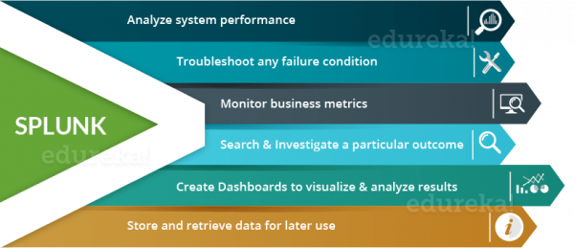
FEATURES

Slide 34
TRAMPOLINE

Slide 35
Trampoline
The aim is to help during developing an application based on the paradigm of microservices with Spring Boot.
Can be used to declare new microservices, start instances, restart and kill them.
It provides a web console which allows to start, stop and monitor the application.
It can be useful if we are running many different applications locally during microservice deployment.

Slide 36
• By default, the web console is available on port 8080, but we can easily override it with the server. port parameter.
• Here are some of its capabilities:
Start instances using Gradle or Maven as a Build Tool
Manage Spring Boot instances
Configure VM arguments during launching phase
Monitor deployed instances: Memory usage, Logs, and Traces
Provide feedback to authors.

Slide 37
Trampoline: Setting up the Service
1.Download Latest Release
Download the latest published release.
Then, start Trampoline, for instance using mvn springboot:run or ./gradlew (or gradle.bat) bootRun.
2.Registering Services
Once we have Trampoline up and running, go to Settings to register first service.
To register a service, name, default port, pom or build location, build tool, actuator prefix, and VM default arguments are needed.

Slide 38
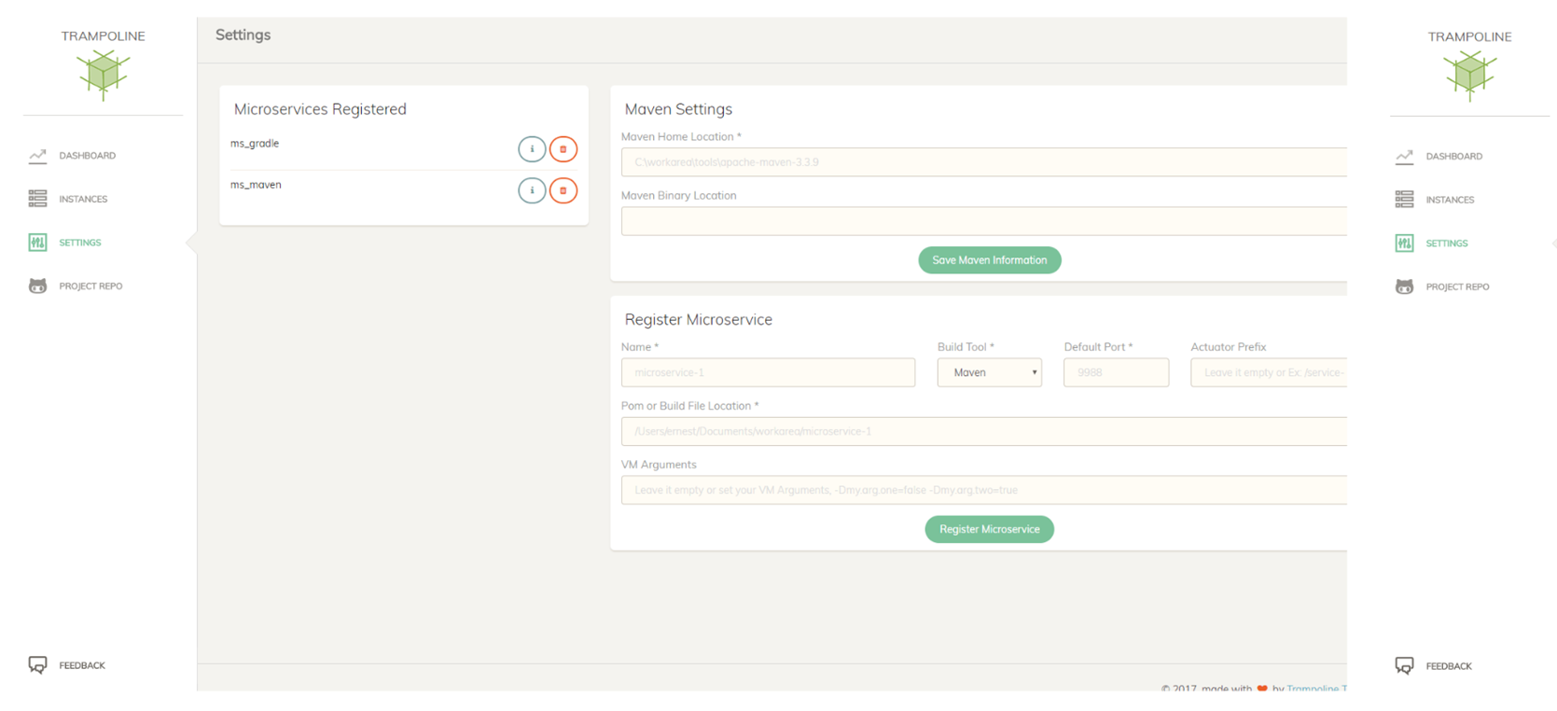

Slide 39
After registering all sample microservices config-service, discovery-service, gateway-service, we may add them to one group. It is a very useful to deploy them all with one click.
We need to include actuator starter dependency in our Spring Boot projects, as well as /logfile endpoint through well-known logging properties:
<dependency>
<groupId>org.springframework.boot</groupId>
<artifactId>spring-boot-starter-actuator</artifactId>
</dependency>

Slide 40
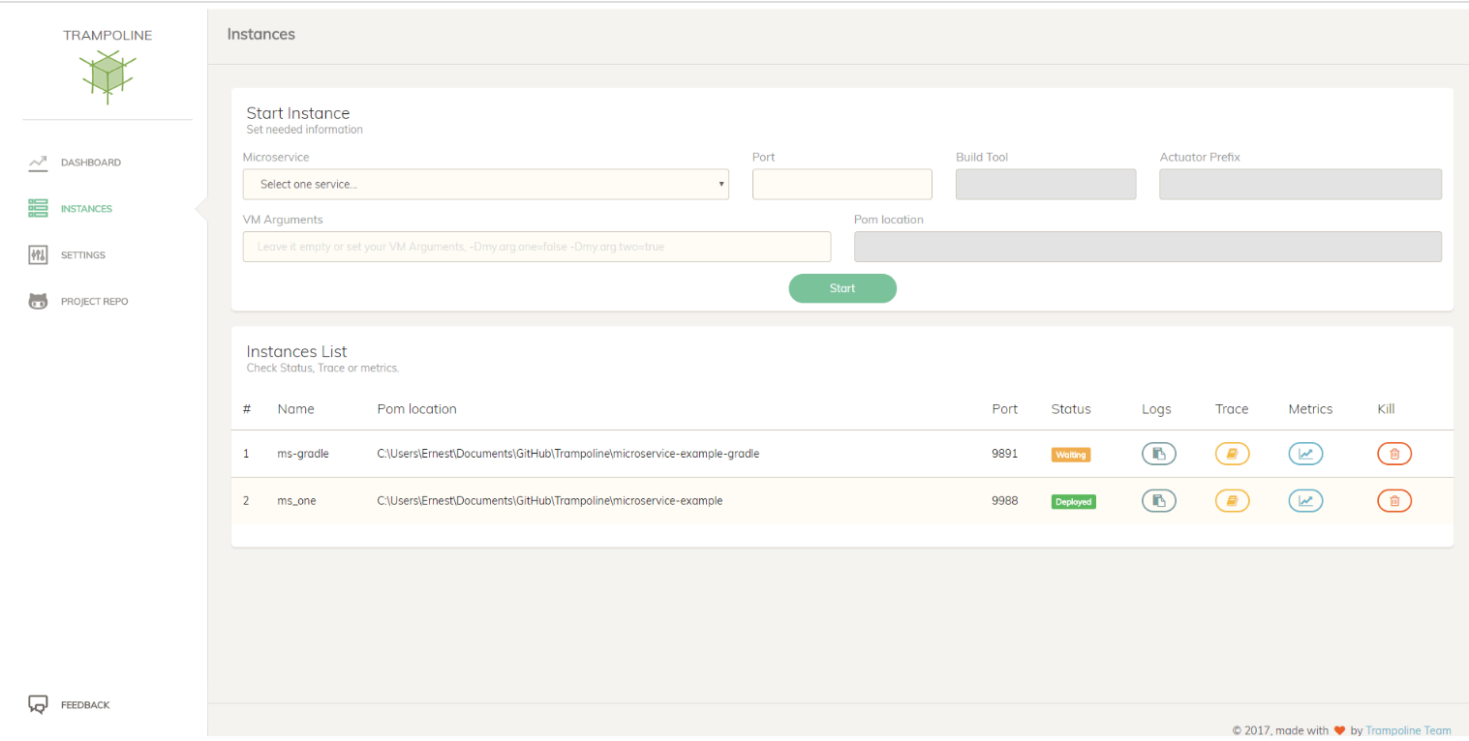
3.Managing Service Instances • Here, we'll be able to start and stop service instances and also monitor their statuses, traces, logs and memory consumption.

Slide 41
4.Dashboard
We can visualize some statistics, such as memory usage from our computer or services registered or launched.
We'll also be able to watch whether required Maven information has been introduced or not in the settings section.

Slide 42
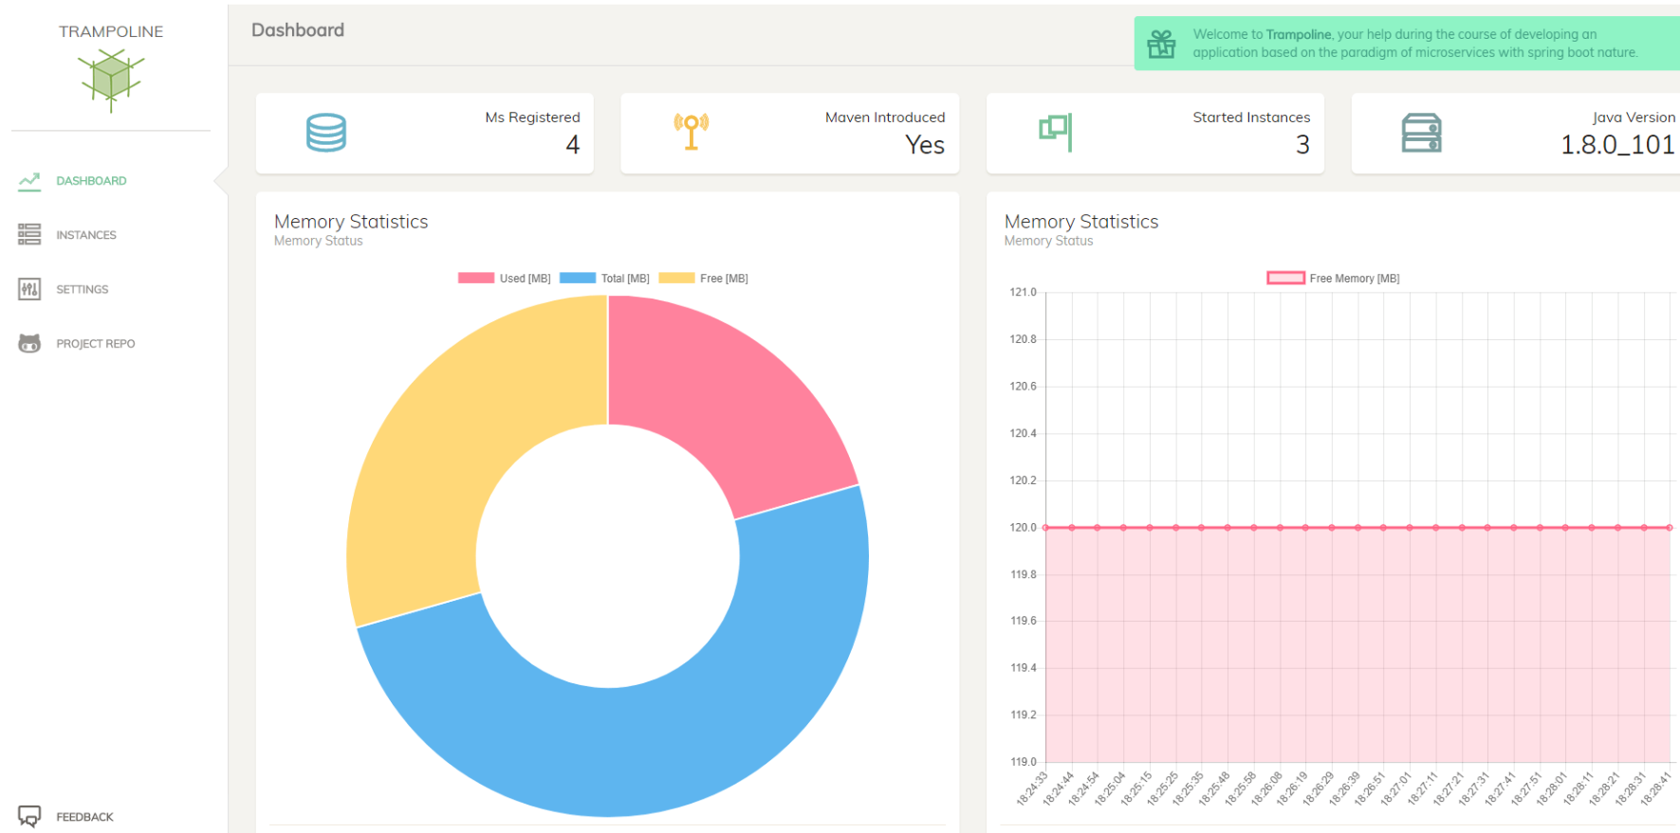

Slide 43
5.Feedback
Through Feedback button it redirects to the GitHub repo where it's possible to create issues or raise questions and enhancements.

Slide 44

Jaeger

Slide 45
Introduction
Most popular open source distributed tracing backend.
CNCF Graduated project.
Created & open sourced by Uber Technologies.
Used for monitoring and troubleshooting microservices-based distributed systems.

Slide 46
Features
Open Tracing-inspired data model.
Multiple built-in storage backends.
Cassandra
Elasticsearch
in-memory
Community supported external storage backends.
System topology graphs.
Adaptive sampling.
Service Performance Monitoring (SPM).

Slide 47
Architecture
Jaeger can be deployed either as an all-in-one binary.
Where all Jaeger backend components run in a single process, or as a scalable distributed system.
There are two main deployment options.
Direct to storage
Kafka

Slide 48
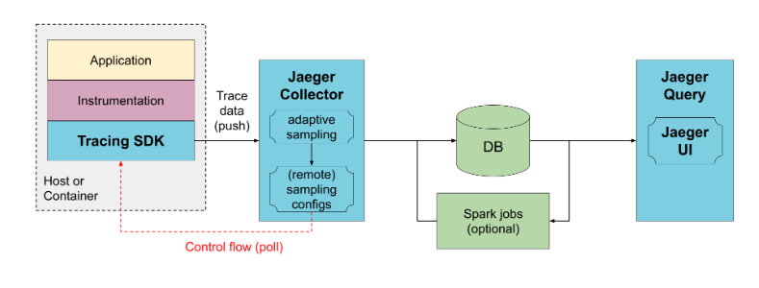
Direct to storage

Slide 49
Collectors receive the data from traced applications and write it directly to storage.
The storage handles both the average and peak traffic.
Collectors use an in-memory queue.
Collectors serve sampling configuration to the SDKs known as remote sampling mode.
Also enable automatic sampling configuration calculation, known as Adaptive sampling.

Slide 50
To prevent data loss between collectors and storage, Kafka can be used as persistent queue.
Jaeger-ingester, needs to be deployed to read data from Kafka and save to the database.
Multiple jaeger-ingesters can be deployed to scale up ingestion.
And they will automatically partition the load across them.

Slide 51
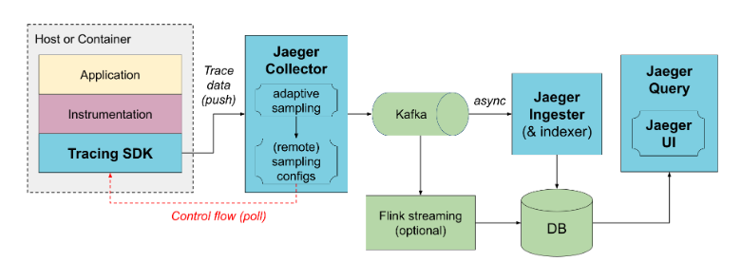
Kafka

Slide 52
Jaeger Tracing Glossary
Client-The component that implements the OpenTracing API for distributed tracing.
Agent-A network deamon that listens for spans sent over User Datagram Protocol.
Collector-The component that receives spans and adds them into a queue to be processed.
Console-A UI that enables users to visualize their distributed tracing data.
Query-A service that fetches traces from storage.
Span- The logical unit of work in jaeger, which includes the name , starting time and the duration of the operation.

Slide 53
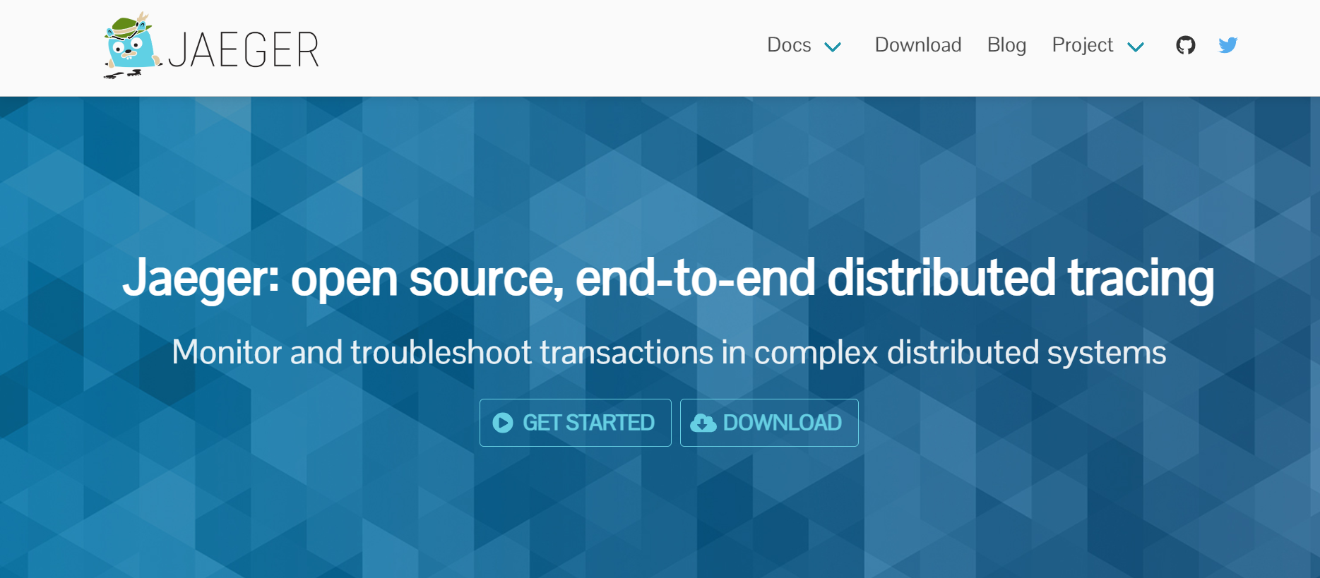

Slide 54
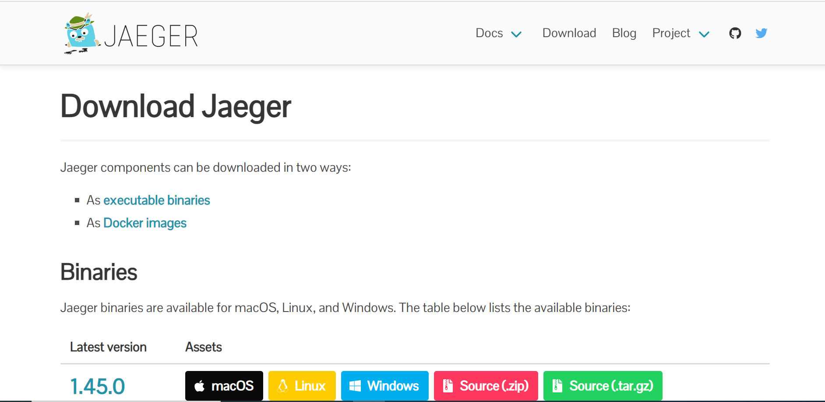

Slide 55
Components
Tracing SDKs
Agent
Collector
Query
Ingester

Slide 56
Tracing SDKs
The Jaeger project provided a collection of tracing SDKs, called Jaeger clients.
These libraries have been retired in favor of the Open Telemetry SDKs.
Agent
Jaeger agent is deprecated.
The Open Telemetry data can be sent directly to the Jaeger backend, or the Open Telemetry Collector can be used as agent.
Collector
Jaeger-collector receives traces, runs them through a processing pipeline for validation and clean-up and stores them in a storage backend.

Slide 57
Query
Jaeger-query is a service that exposes the APIs for retrieving traces from storage .
It hosts a Web UI for searching and analyzing traces.
Ingester
Jaeger-ingester is a service that reads traces from Kafka and writes them to a storage backend.
It is a stripped-down version of the Jaeger collector that supports Kafka as the only input protocol.

Slide 58
THANK YOU
Akhil Murali (akhil.murali@ust.com)
Amitha Mary Benny (amitha.marybenny@ust.com)
Devika Bijo (devika.bijo@ust.com)
Meenakshi Sajeevan (meenakshi.sajeevan@ust.com)

